Slide 1

Project Presentation of
Mini project on:-
AMS CHATBOT
By:-
Guided by:-
Aditya Kumar yadav
1905080100006
IIIrd year , CS31
Mrs. Saroj Singh
( Associate Professor, CS&E,BBDEC)
DEPARTMENT:-- CSE

Slide 2
CONTENTS
01) INTRODUCTION.
02) OBJECTIVE
03)MODULES USED
04)OUTPUT
05)WORKING.
06)FLOW CHART
07)AVAILABLE APPLICATION.
08)VPAs IN FUTURE.
9) CONCLUSION.
10)REFRENCES.

Slide 3
INTRODUCTION
This project is basically a chatbot which can perform some easy and simple tasks like wishing you, opening YouTube, Google, Wikipedia, etc.
And the second big property of this project is that is can store account details and can modify them on your wish.
It is divided in two basic steps
Artificial intelligence:-
It is the ability of a computer or a robot controlled by a computer to
do tasks that are usually done by humans because they require
human intelligence and discernment.
Data management:-
It stores the details related to accounts to a file in the system and it
modifies or shows all the record according to your instruction it performs
task like adding account, debit and withdraw , modify and delete data.

Slide 4
Objective
To open applications without going through all the steps.
To store the data.
To modify the stored data.
To create conversation between system and user.

Slide 5
BASIC CONCEPT USED
The working of chatterbot uses following principles:
Natural Language Processing.
To speak in the language which are understood by everyone
Text input:-
To get the command from user.
Artificial intelligence.
To learn things from user and to store all.
Inter Process Communication .
To get important information from other software application

Slide 6
Module used
Pyttsx3:-pyttsx3 is a text-to-speech conversion library in Python. Unlike alternative libraries, it works offline, and is compatible with both Python 2 and 3.
Date & time:-Datetime module supplies classes to work with date and time. These classes provide a number of functions to deal with dates, times and time intervals. Date and datetime are an object in Python, so when you manipulate them, you are actually manipulating objects and not string or timestamps.
Wikipedia :- Wikipedia is a Python library that makes it easy to access and parse data from Wikipedia. Search Wikipedia, get article summaries, get data like links and images from a page, and more. Wikipedia wraps the MediaWiki API so you can focus on using Wikipedia data, not getting it.

Slide 7
MODULE DESCRIPTION
4. Webbrowser:-The webbrowser module provides a high-level interface to allow displaying Web-based documents to users. Under most circumstances, simply calling the open() function from this module will do the right thing.
5. OS :-The OS module in python provides functions for interacting with the operating system. OS, comes under Python's standard utility modules. This module provides a portable way of using operating system dependent functionality. The *os* and *os. path* modules include many functions to interact with the file system.
6. Pathlib:-Pathlib module in Python provides various classes representing file system paths with semantics appropriate for different operating systems. This module comes under Python's standard utility modules. Path classes in Pathlib module are divided into pure paths and concrete paths

Slide 8
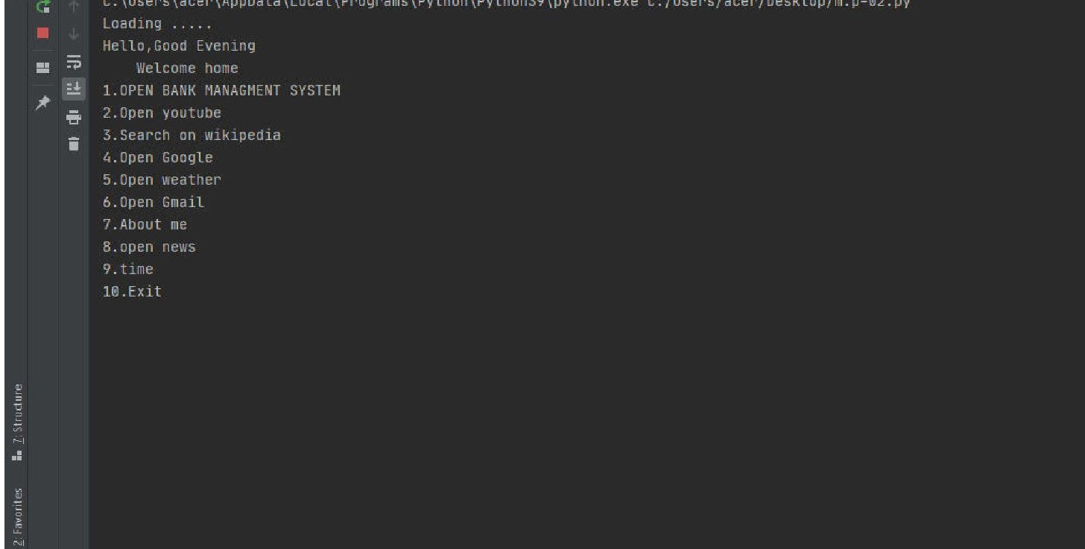
OUTPUT
This is the output which will come directly to you once you run the program in this part the A.I
The output screen gives you pretty much idea of what task it can perform.

Slide 9
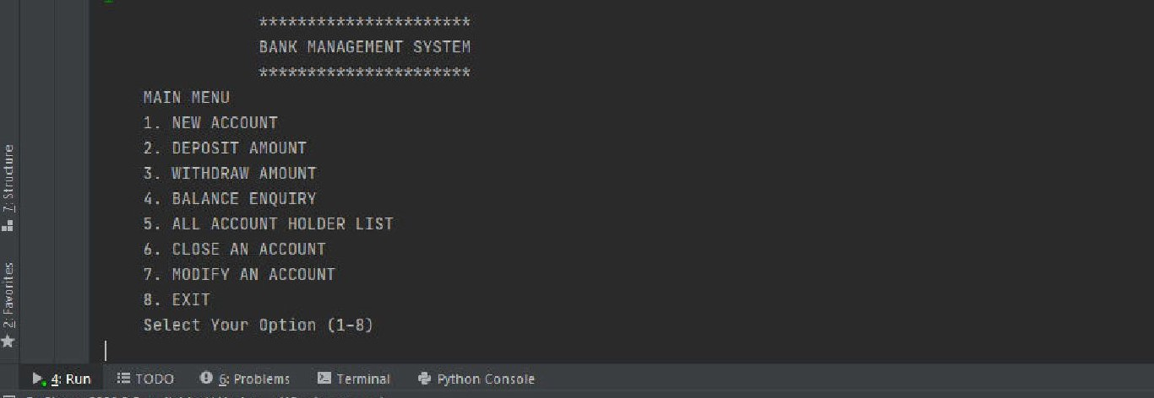
This is output screen when you ask the assistant who are you . He will tell you what things he can do .
There are many other operations which assistant can do like opening YouTube or Gmail ,
etc for you but I can’t show that in the screenshots so i have put the things assistant can do for
you in written form so you can him what things he is capable of doing.

Slide 10
WORKING
This program is divided in 2 parts
Chatbot:-
Text to speech
Text analyzing
Interpret command
Data management

Slide 11
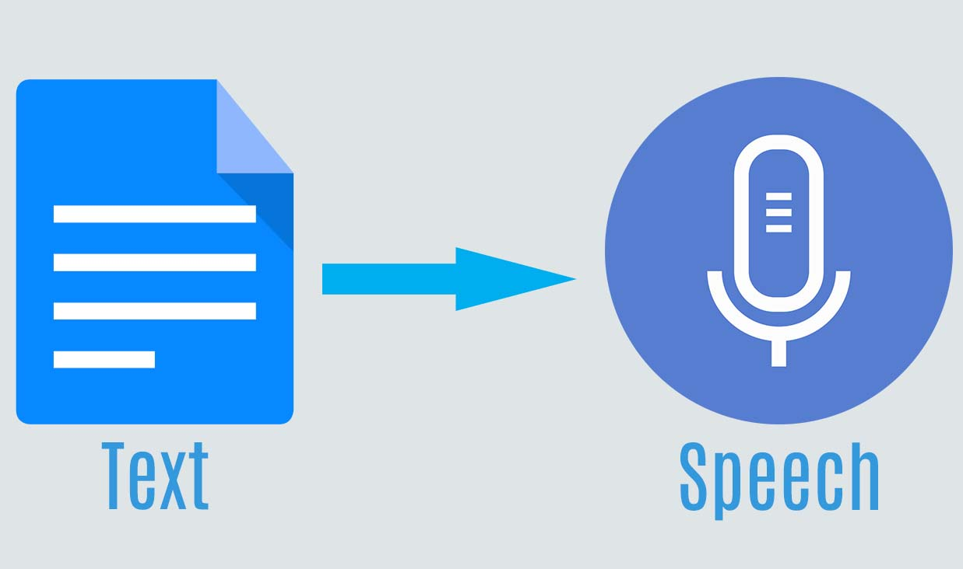
WORKING-TWO LAYERS
1.1)TEXT TO SPEECH:-
A pyttsx3 software used that converts text to speech in pycharm.
1.2) TEXT ANALYZING:-
Converted text is just letters for computer.
A piece of software converts text to something that is understandable for computer.
Computer understands the command, so virtual assistant like siri convert this text to computer command.

Slide 12
WORKING- TWO LAYERS
VPAs maps the words to functions and parameters to create a command that computer can understand
example of Reminder.
1.3) Interpret commands:
In this layer, that mapped computer command, go to server through internet.
Simultaneously, you speech evaluated locally.
A local recogniser communicate with server to judge whether command will be best handle locally or not.
example: PLAY MUSIC,OPEN YOUTUBE,GMAIL.

Slide 13
WORKING- TWO LAYERS
2) Data management:-
In this part we store the data offline and manage the data and can perform multiple task like adding the data, deposit and withdraw ,balance enquiry, output all entry , remove a data, modify
the data.

Slide 14
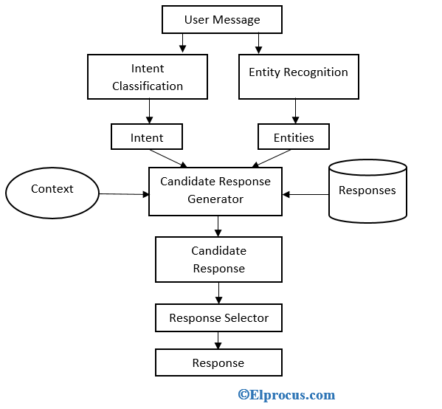
FLOW CHART

Slide 15
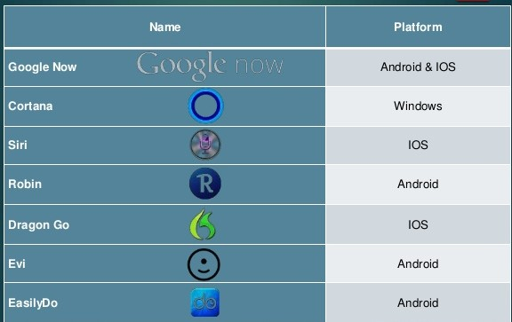
AVAILABLE APPLICATION

Slide 16
Features
Some of the features of Virtual assistant, you may
ask him in day by day uses are shown below:
Make phone calls.
Open applications.
Schedule meetings & appointments.
Get direction.
Send messages.
Set reminders .
Ask questions.
Play music& video.
Alarm.

Slide 17
Advantages
These applications make small and smart hand-held devices to combine multiple features.
They allow you to export and import data.
Store various information.
Make to do lists.
Recognizes voice commands.
Controls various applications of device.
Provides services regarding your location.
Helps to plan your whole day.
Reminds you important things on accurate situations or location.

Slide 18
DIS-ADVANTAGES
Listening problem.
VPA get problem to process wrong.
Silent mode support.
VPA gives response in voice output
thus it doesn’t work properly in silent mode.
Internet access.
VPA needs internet connection to give desired output.

Slide 19
CONCLUSION
Virtual chatbot are very effective way to organize your schedule. Now there are many smart chatbot application available in market for various device platform.
These new Software applications are performing really well than PDA devices as they provided with all resources of your Smartphone.
VPAs are more portable and you can use them anytime. They also have lot of information than any assistant as they are connected with internet.

Slide 20
REFERENCE
PYTHON COURSE:
https://www.python.org/about/gettingstarted/-
Online :-
Wikipedia
A.I history
Photos
Comparison
Web sites:-
https://www.livescience.com/49007-history-of-artificial-intelligence.html.

Slide 21
Thank you

